Slide 1

PrevWORKS
™
WELLNESS + PREVENTION = PRODUCTIVITY®

Slide 2


Fact is,
Corporates are increasingly involved in strategies to improve workforce health and seek value in medical expenditure.
But the growing burden of health care costs on employers necessitates innovative solutions to demonstrate value and return on investment.
UNAUTHORIZED DISTRIBUTION OR DISCLOSURE OF THE INFORMATION IS STRICTLY PROHIBITED
Notes:
Stress associated with utilizing an electronic health records (HER) is universal, irrespective of the HER being used. Many practices think HER is very little help in clinical decision and patient care, but it is associated more with satisfying billing needs. The misconception necessitates increased clinician involvement in this area to reduce burden and make HER system in order to help reduce screen time and increase face to face time with the patient.
The growing burden of health care costs on employers has motivated increasingly direct corporate involvement in strategies to improve workforce health and seek value in medical expenditures. As a result, many employers are considering work-site health clinics, which are well suited to a PCMH model.
Successful transformation of an occupational medicine-focused work-site clinic into a medical home caring for thousands of patients.
Leveraging strengths and overcoming barriers to implementation, establishing a timeline and care team uniquely suited to both corporate and patient needs, and utilizing a pilot program to demonstrate value and return on investment.

Slide 3
Problem Analysis
Higher Costs
EFFECTS
Unsustainable Medical Care
Decreased Productivity
Increased risk for filing WC claims
Inadequate safety practices
Job demands
Health risks
Insufficient support services
Lack of motivation
CAUSES
UNAUTHORIZED DISTRIBUTION OR DISCLOSURE OF THE INFORMATION IS STRICTLY PROHIBITED

Slide 4
What is PrevWORKS™ ?
It is Corporate/Worker-Centered Occupational Health (CWCOH) system
Combines mobile technology with clinic-based interventions to transform occupational medicine-focused practice into value-based care uniquely suited to serve both corporate and worker needs.
Promotes wellness and prevention for workers and gives the power of lowering costs for corporates.
UNAUTHORIZED DISTRIBUTION OR DISCLOSURE OF THE INFORMATION IS STRICTLY PROHIBITED

Slide 5

A Game Changer
PrevWORKS™ interactive scalable technologies use data and analytics to:
A. Enhance risk management using
proprietary work-demand Risk
Calculator.
B. Promote industry-tailored and reliable
preventive practices.
C. Reduce administrative burden.
D. Navigate worker’s comp claims in
timely manner.
Notes:
Oftentimes the practices’ teams are uncertain how to organize their groups and decide what to submit and when. This interactive model will assist organization with multiple practice sites for PCMH recognition.
Set up site groups, share criteria, and organize and prepare sites to go through the virtual check-in process
Discuss corporate-wide evidence vs. site-specific evidence
Outline tips for presenting evidence to your evaluator to reduce administrative burden
Discuss the suggested recognition pathways for multi-sites to determine readiness for scheduling the virtual review
Organizations will see how to use their recognition account to link sites in Q-pass for multi-site submission
It is a hands-on, highly interactive session

Slide 6
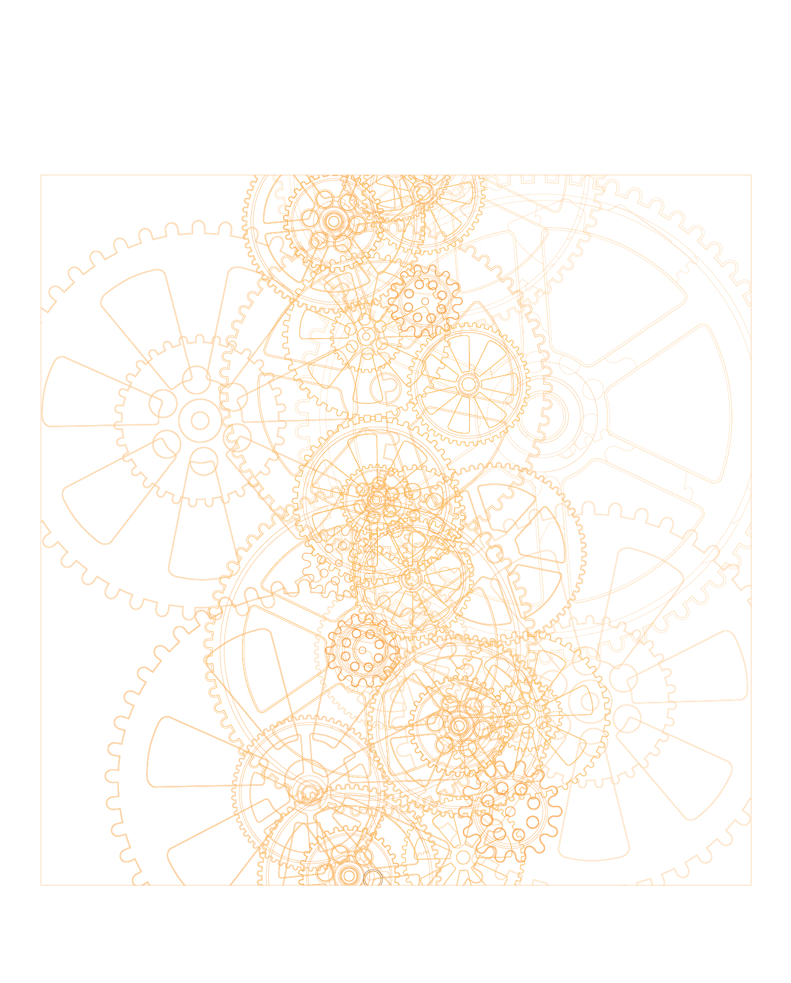
Centralizing Analytics
PrevWORKS™ dual Corporate/Worker proprietary platforms are created to build data-driven value-oriented architecture for cognitive computing. Using industry-specific data to anticipate and prepare for future occupational health events:
Algorithms
Data Driven insights
Predictive Analytics
Forward-Looking Data

Slide 7

Risk Adjustment
PrevWORKS™ anonymization algorithms are unique in delivering predictive and prescriptive analysis for segmenting risk and communicating data-driven insights to achieve precision medicine, predict outcomes and identify the most appropriate interventions to improve wellness and safety in pre-injury care, efficiency and quality in post-injury management.
UNAUTHORIZED DISTRIBUTION OR DISCLOSURE OF THE INFORMATION IS STRICTLY PROHIBITED

Slide 8

Instant Intake Process
Customized Corporate Access
Mobile App/Dashboard (C-PASS)
Industry specific profile and data analysis
Workforce injury trends and other metrics
Evidence-based intervention protocols and recovery time-line for medical treatment of injuries
Risk calculations based on work type, age and gender
Interactive access to management of care data
Develop benchmark metrics
Real-time Feedback on safety and prevention standards
Pre-paid wellness packages and workshops
Notes:
Services Offered
In the room, be sure to mention PrevWORKS’ proprietary algorithms that define occupational risks, and its database of employee medical data.

Slide 9
Instant Intake Process
Customized Worker Access
Mobile App/Dashboard (W-PASS)
Individual profile login
Instant access for reporting injury
Interactive access to management of care process
Real-time Feedback on safety and prevention standards
Pre-paid wellness packages and workshops
Custom-made tools to address workplace ergonomics, stress and behavioral health data.
Notes:
Services Offered
In the room, be sure to mention PrevWORKS’ proprietary algorithms that define occupational risks, and its database of employee medical data.

Slide 10
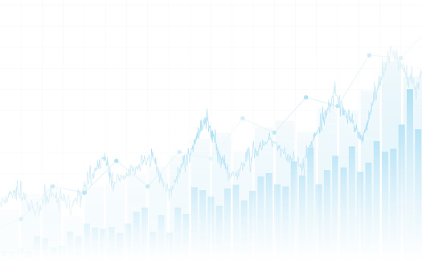
Corporate Access (C-PASS)
Notes:
A check-in is conducted virtually online with a prevWORKS Evaluator, who will evaluate the practice’s progress towards recognition and provide immediate, personalized feedback. Before each check-in, the practice gathers and prepares evidence and uploads it through Q-PASS. At each virtual review session, the practice uses screen-sharing technology to provide evidence virtually and answer the evaluator’s questions about pre-submitted documentation.
The virtual review process prompts the practice to prepare less documents and conduct more virtual, real-time demonstration of their systems, workflow, and reports. It is an opportunity for the practice to tell their story and showcase how they have transformed to provide more patient centered care.
Determining what to show the evaluator, paper evidence or screen sharing, is often a challenge for practices. Too much time is spent creating documents, capturing screen shots, and downloading reports when much of this evidence could be shown to the evaluator during the virtual review.
The interactive workshop will help the practice team determine what type of evidence is best to demonstrate how they meet the intent of the PCMH standards.
Outline tips to help decide what to show in a document versus what to explain and show during the virtual review.
Corporate/worker-Centered Occupational Health CWCOH is a future vision for advanced occupational care that requires consensus on investment, training, workforce and other resources
PrevWORKS is increasing lever to achieve more robust, team-based and Corporate/Worker-Centered Occupational Health.

Slide 11
Corporate Access (C-PASS)

Slide 12
Corporate Access (C-PASS)

Slide 13
Worker Access (W-PASS)

Slide 14
Worker Access (W-PASS)

Slide 15
Workplace Safety Benefits
Source: Huang et. al., 2009. Data based on responses from 231 U.S. companies with 100 or more employees.
Notes:
PrevWORKS will have protocols around its processes, data-mining, and algorithms. All of these will lead to enhanced workforce productivity.

Slide 16

Numbers Are Impressive
A recent Federal Occupational Health (FOH)
Employee Assistance Program (EAP) survey found that EAPs resulted in:
69.2% improvement in Absenteeism
22.8% improvement in Work Presenteeism
24.2% improvement in Life Satisfaction
Bottom line takeaway: An EAP resulted in multidimensional employee performance improvement
Source: Mintzer and Morrow, “Demonstrating Value Measuring Outcomes and Mitigating Risk”

Slide 17

The Value of PrevWORKS™
According to a national claims organization, about 40% of injury events only require self-care, including treatment at the worksite. Another small percentage of work injuries requires emergency care at the hospital. The remaining vast majority of lost-time compensable claims should be addressed at walk-in clinics. PrevWORKS™ is programed to influence the direction and quality of the downstream care.
$13,000 Claim
1.09 EMR x 29,000 Premium
$31,615 Modified Premium
Generates an EMR of 1.09
No Claims
0.90 EMR x 29,000 Premium
$26,100 Modified Premium
Generates an EMR of 0.90
PrevWORKS saves $5,515
Notes:
Statistics, if needed
Jeffrey Mintzer and Veronica Morrow at the Health and Human Services, Federal Occupational Health performed a study titled: “Demonstrating Value Measuring Outcomes and Mitigating Risk” exploring whether Employee Assistance Program (EAP) contributes to the improvement of 5 areas: absenteeism, presenteeism, work engagement, life satisfaction and workplace distress. 4,800 respondents were surveyed at EAP intake (pre EAP engagement) and 30 days following engagement (post EAP engagement). Results demonstrated the positive impact of using the EAP. Specifically: 69.2% improvement in Absenteeism, 22.8% improvement in Work Presenteeism, 2.8% improvement in Work Engagement, 24.2% improvement in Life Satisfaction, 10.0% improvement in Workplace Distress. FOH EAP was instrumental in improving employees’ work performance through multiple dimensions.

Slide 18

A Few Final Words
PrevWORKS™ is an ambitious collaborative model that guarantees a win for workers, corporate and payer.
Our key innovations are centered around predictive and prescriptive modeling for risk determination, performance maximization, and safety optimization.
PrevWORKS™ mobile technology put forth sustained efforts to engage workers and corporates to improve outcomes, contain losses, and boost core competencies in workers’ comp claims management.
The hallmark of PrevWORKS™ advocacy is to retain value in medical expenditure while promoting healthier and productive workforce.
Case Closed.

Slide 19

Notes:
Q+A
Stay and answer as many Qs as they have!

Slide 20

Let’s Connect
Dr. Naila Khalaf
nkhalaf@prevworks.com
PH: 213.446.1050
Notes:
Ask them for next steps – have suggested your ideal next steps ready to go

